Slide 2


Cryptographic Protocols - WEP
Wired Equivalent Privacy
Weak
Uses a static key
64-bit or 128-bit key
RC4 stream cipher
CRC checksum
Notes:
Client presents the list of supported cipher suite

Slide 3
Cryptographic Protocols - WPA
Wi-Fi Protected Access
Weak
Uses Temporal Key Integrity Protocol
Per-packet encryption
RC4 stream cipher
Message Integrity Check
Notes:
Client presents the list of supported cipher suite

Slide 4

Cryptographic Protocols – WPA2
Wi-Fi Protected Access 2
Stronger
Uses CCMP
Advanced Encryption Standard
128-bit key
Notes:
Counter Mode Cipher Block Chaining Message Authentication Code Protocol and AES

Slide 5
Cryptographic Protocols – WPA3
Wi-Fi Protected Access 3
Strongest
Uses SAE
128-bit or 192-bit encryption
Notes:
Simultane

Slide 6
Authentication Protocol
EAP/PEAP
EAP-FAST
EAP-TLS
EAP-TTLS
Notes:
Identity to remote users/computers

Slide 7
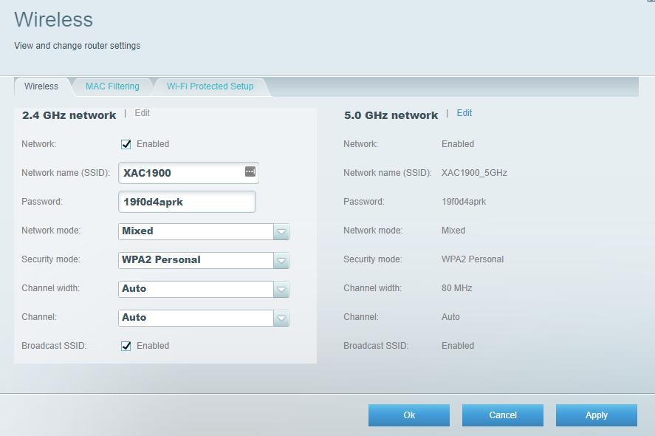
Authentication Methods – Pre-shared Key
Notes:
http://ui.linksys.com/X6200/
Change from

Slide 8





Authentication Methods – Enterprise
(Wireless Client)
(802.1X compliant AP/WLC)
(RADIUS Server)
WLAN controller
Notes:
http://ui.linksys.com/X6200/
Change from

Slide 9
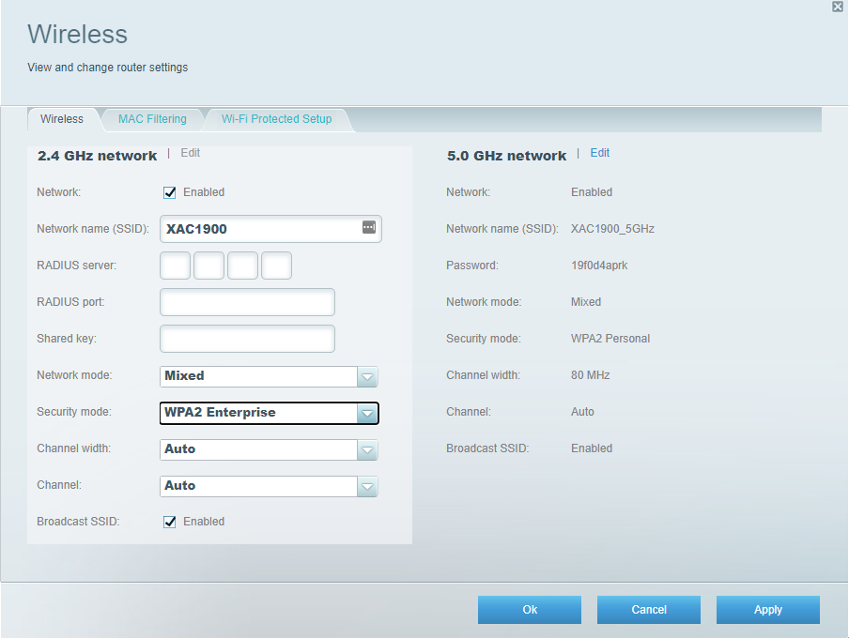
Authentication Methods – Enterprise
Notes:
http://ui.linksys.com/X6200/
Change from

Slide 10
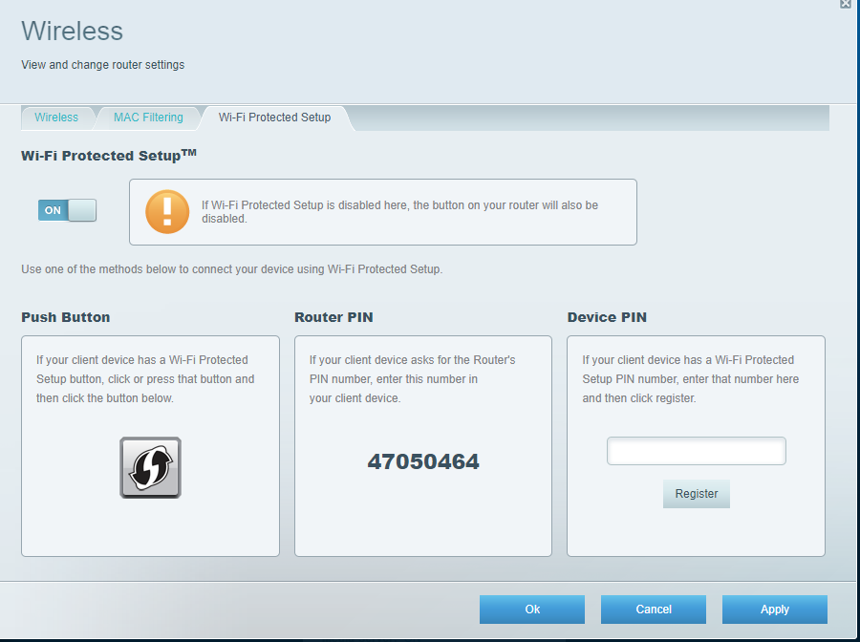
Authentication Methods – Wi-Fi Protected Setup
Notes:
http://ui.linksys.com/X6200/
Change from

Slide 11
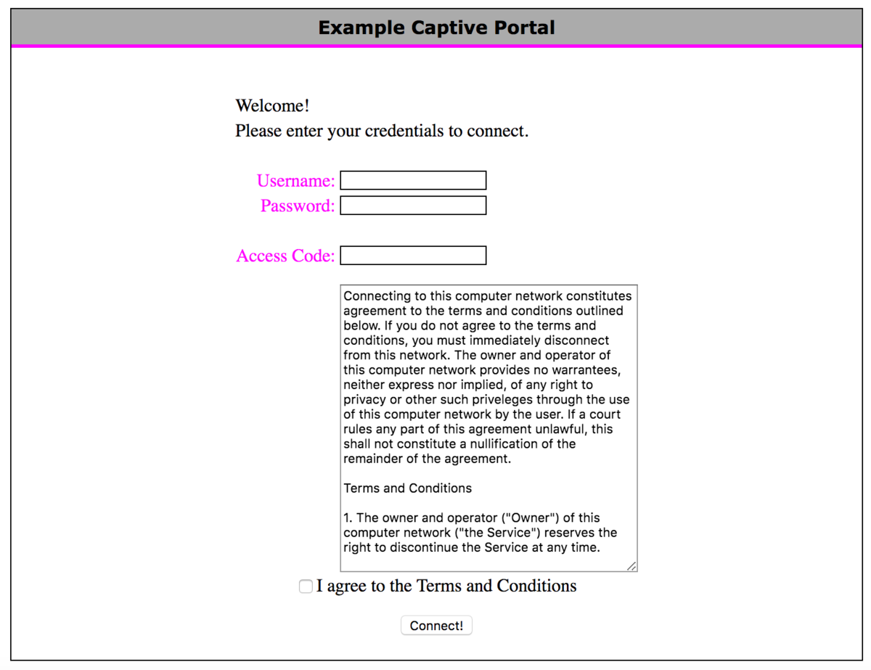
Authentication Methods – Captive Portal
Notes:
http://ui.linksys.com/X6200/
Change from

Slide 12
Installation Considerations
Channel overlay
Congestion
Wireless Access Point (WAP) placement
Heatmaps and Site Surveys
Controller and AP security

